Slide 1
Data Mining Applications Revisited

Slide 2
Important: Business Case for Business Intelligence
Competitive
Advantage
Higher
Predictive Metrics
“What will happen?”
Business
Value
Descriptive/Assessment Metrics
“Why has it happened?”
Baseline Metrics
“What has happened?”
Lower
Higher
Data
Information
Analysis
Insight
Recommended
Actions
Complexity of Analysis
Source: www.eforceglobal.com
Notes:
Need to be able to ask relevant questions of the data.

Slide 3
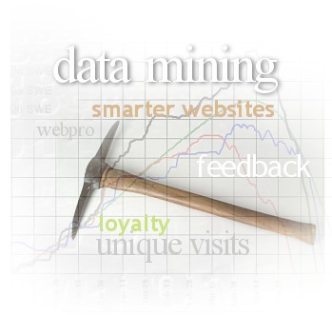

Data Mining (Recall)
Includes:
Identifying valid, novel, potentially useful, and ultimately understandable patterns in data
Searching for relationships, patterns, and trends not known to exist or not visible
Providing answers to questions decision maker not thought to ask
Requires:
Information technology
Statistics
Business knowledge
Notes:
Data mining uses artificial intelligence tools and statistical analysis to analyze data
For data mining to work, two critical conditions needed:
Organization must have clean, consistent data
Events in that data should reflect current and future trends

Slide 4
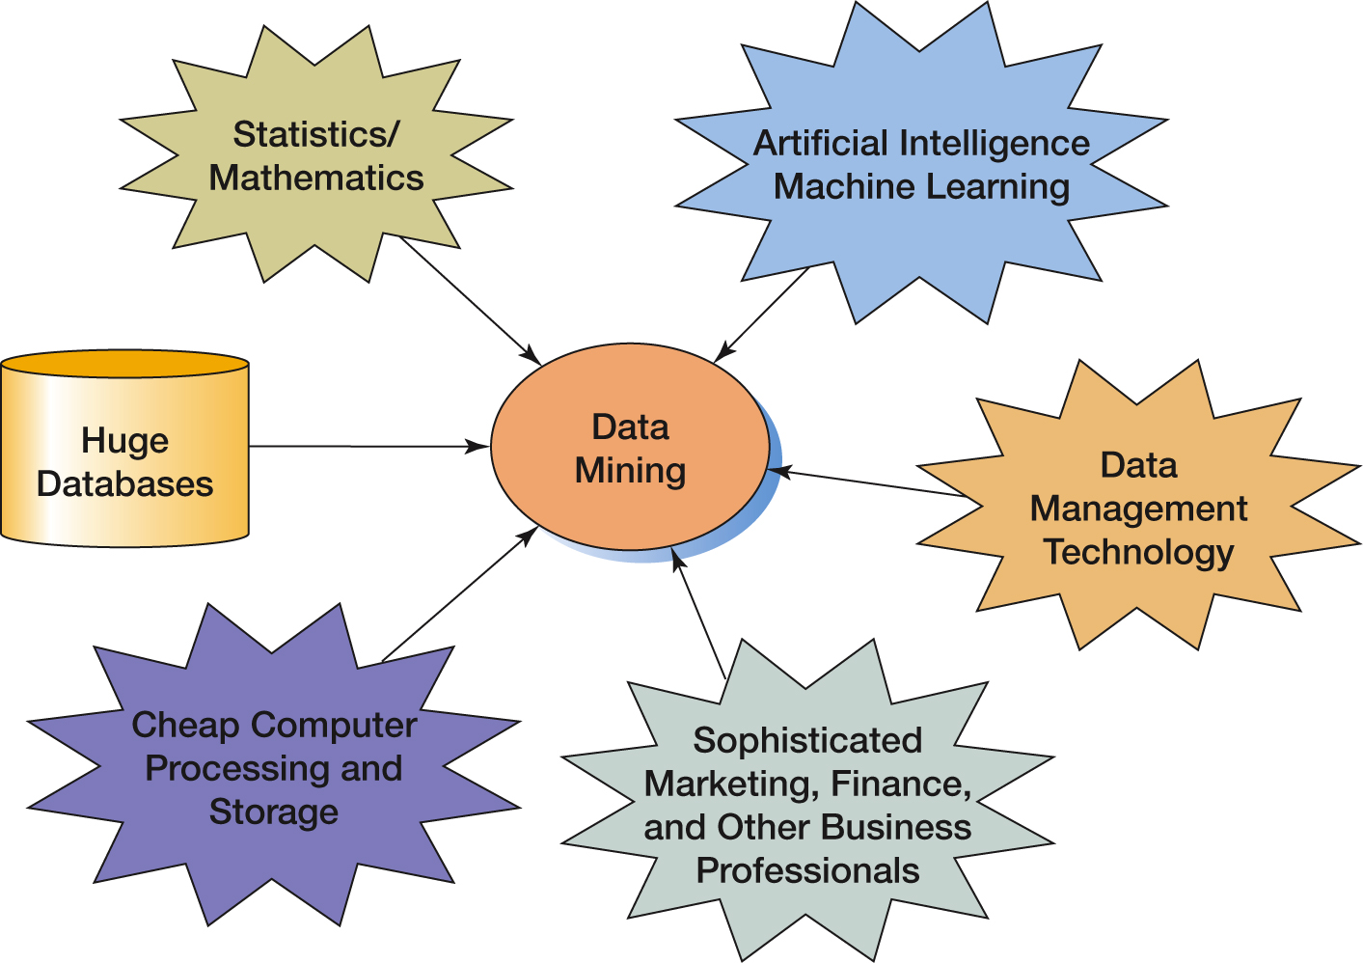
Figure 12-25 Convergence of Disciplines for Data Mining

Slide 5
Important: Knowledge Production
Knowledge
Pattern Evaluation
Data Mining
Task-relevant Data
Data Warehouse
Selection
Data Cleaning
Data Integration
Databases
Notes:
Note that different parts of this can repeat.
If you obtain patterns via data mining, but evaluate them to not be useful, then you need to start over again with the data mining process, mostly likely including different variables. Different subsets of the data. Perhaps apply different techniques.

Slide 6
Data Mining: Applications
Marketing and Promotion Targeting
Prospects for e-mailing list
Customer Segmentation
Common characteristics of customers who buy same products
Market Basket Analysis
Which products likely to be bought together
Customer Churn
Which customers likely to leave
Fraud Detection
Patterns of fraudulent transactions; compare current transactions
Collaborative Filtering
Personalization based upon similar customers
Financial Modeling
Trading systems based upon historical data
Hiring and Promotion
Based upon employee characteristics
Source: T. Melone, Gallaugher

Slide 7




Example: Predictive analytics (Herschel)
If we target, the customer will:
Stay
I Am Persuadable!
I Am a Sure Thing
If we do nothing, the customer will:
Churn
Stay
Managerial implications?
I Am a Lost Cause
I Am a Sleeping Dog
Copyright Pitney Bowes Software
Garner, Herschel
Churn
Notes:
Predictive analytics is being applied to a variety of different business issues, with customer retention a high priority for many companies.
Analysis of some customer retention programs has raised the issue that, for certain segments of the customer base, a targeted retention program can actually increase churn rates, rather than reduce them. Dubbed "sleeping dogs," these customers are unlikely to churn due to inertia rather than loyalty, and the act of targeting them with a retention offer "activates" them into an evaluation and decision cycle that they would otherwise not begin.
The concept of uplift analysis seeks to identify the group that most traditional predictive models would struggle to separate from normal high-risk customer groups. The same principle can be applied to the acquisition and cross-sell process, asking the question, "Who will we acquire, only if we extend them an offer?" instead of the more general "Who are we likely to acquire?"
This concept of uplift analysis was pioneered by Quadstone (now part of Pitney Bowes Business Insight), although a number of other data mining vendors have this capability under development.

